Slide 1
Physics 5350: Methods of Theoretical Physics II
Spring Semester, 2018
Utah State University Department of Physics
Instructor: Dr. Ludger Scherliess
Ludger.Scherliess@usu.edu
SER 316
797-7189
Course Objectives
Understand and implement some important numerical methods used in computational physics.
Gain confidence solving problems numerically using Fortran 90.
Lecture: Class will meet W/F in SER 122 at 9:00 AM – 10:15 AM
Office Hours : By Appointment

Slide 2
Syllabus
Homework: Several homework assignments (5-6) will be given during the course of the semester that are due on specified due dates (at the beginning of the lecture). Homework must be received on time for full credit unless there is a valid excuse. The homework score will be proportional to the percentage of assigned problems turned in on time with substantial work done on them.
Quizzes: There will be 2-3 short quizzes throughout the semester (mostly multiple choice)
Midterm Exam: There will be a one-hour late midterm exam. A page of useful formulas will be provided as well as numerical values of useful constants.
Final Project: There will be a final project toward the end of the semester.
Final Grade: Your letter grade will be assigned on the basis of a numerical distribution combining scores from exams, homework, quizzes, and a final project. The distribution will be determined using the following proportions:
Homework 40%
Late Midterm 30%
Final Project 20%
Quizzes 10%
Total 100%

Slide 3
Syllabus
A percentage score will be computed for each student and the letter grade assigned according to the conversion table below:
Letter grade A A- B+ B B- C+ C C- D+ D D-
% score 92 90 88 82 80 78 72 70 68 62 60
The scores represent the lower bound for the adjacent letter grades. For example a B grade will be given for all aggregate % scores, weighted as described earlier, which fall between 82.0% and 87.9%. Marks below 60% will be graded F.

Slide 4
Syllabus
I. Introduction
· Accuracy in computing
· Fortran 90
· Local interpolation and cubic splines
· Definite integrals : trapezoidal rule, Romberg integration and adaptive integration
II. Ordinary Differential Equations (ODE's)
· Linear and Nonlinear ODE's
· Initial value problems: Runge-Kutta and adaptive methods
· Boundary value problems: shooting and finite-difference methods
III. Partial Differential Equations (PDE's)
Parabolic (diffusion), elliptic (Poisson), hyperbolic (wave/advection)
· Finite-difference and finite-element spatial discretization
· Explicit, semi-implicit and implicit time-stepping schemes
· Stability analysis

Slide 5
Syllabus
Official Text: Lecture Notes and Handouts (on Canvas)
Reference Texts:
Undergraduate texts
Introduction to Numerical Methods (Stark)
Applied Numerical Analysis (Gerald & Wheatley)
A First Course in Computational Physics (DeVries & Hasburn)
Numerical Methods for Physics (Garcia)
Graduate Texts:
Introduction to Numerical Analysis (Stoer & Bulirsch)
Numerical Recipes in Fortran 77 (Press, Teukolsky, Vetterling & Flannery)
Numerical Recipes in Fortran 90 (Press, Teukolsky, Vetterling & Flannery)
Computational Methods for Fluid Dynamics (Ferziger & Peric)
Fortran 90 References:
Upgrading to Fortran 90 (Redwine) best Fortran 90 reference
Intro. to Fortran 90 (Nyhoff)
An Intro. to Fortran 90 for Scientific Computing (Ortega)
Intro. to Fortran 90/95 (Chapman)
Numerical Recipes
http://www.nr.com/oldverswitcher.html

Slide 6
Useful FORTRAN 90 Reference
http://www.docs.hp.com/en/B3908-90006/B3908-90006.pdf
Link to the complete reference book in PDF-format.
This book has many good examples and a good list of the intrinsic functions available in Fortran 90.
Best of all: It is free!

Slide 7
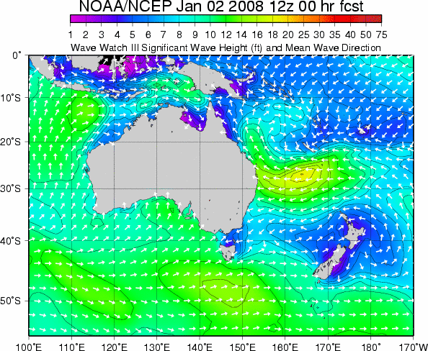
Example of a numerical solution of a PDE

Slide 8
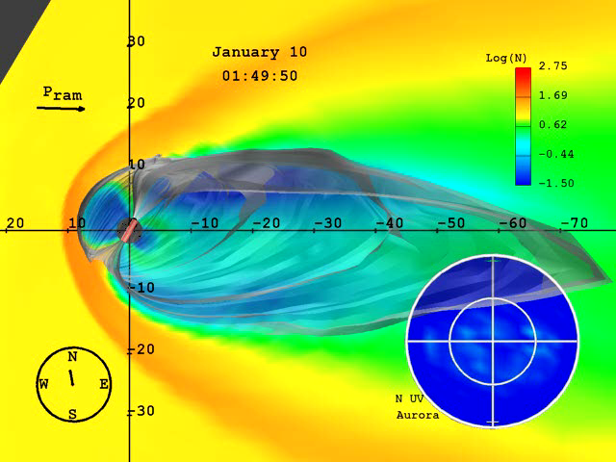
Example of a numerical solution of a PDE

Slide 9
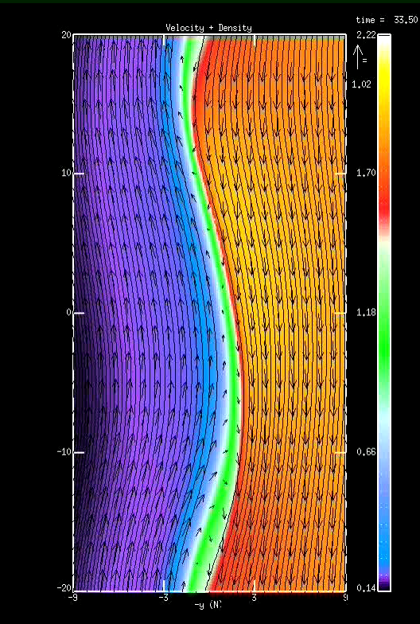
Example of a numerical solution of a PDE
This simulation shows whirlpools of electrically charged gas (plasma), some 40 000 kilometers across, as those witnessed by ESA’s Cluster in the Earth's magnetosphere on 3 July 2001.

